Slide 1
Flare
Community Emergency Alerts Platform
Pearl Hacks 2026
Presented by: Medha Nagaluri, Sanjana Nukala, Sophia Moloo, Siya Patel
Flare
Pearl Hacks
2026

Slide 2





Meet the team
Medha Nagaluri
Sanjana Nukala
Computer Science, Data Science
Computer Science, Media and Journalism
Sophia Moloo
Siya Patel
Computer Science and Environmental Science
Computer Science, Data Science
Flare
Pearl Hacks
2026

Slide 3
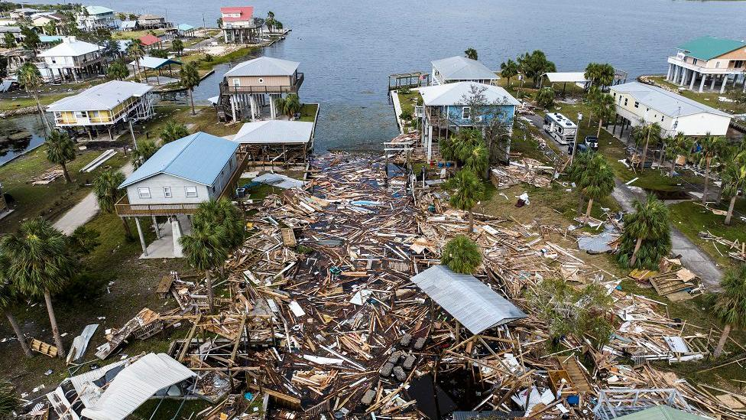
Why we built this
Flare
Pearl Hacks
2026

Slide 4
Purpose
Flare was built to decentralize emergency reporting. Our goal is to replace slow, centralized systems with a high-speed, community-verified network.
Verified: Community upvotes determine the credibility of every report.
Instant: Real-time data pushing ensures alerts reach users the second they are raised.
Customizable: Users set their own safety thresholds, putting the power of information back in their hands.
Flare
Pearl Hacks
2026

Slide 5


Personas
Community/ User Profile
Admin/ Emergency Responders
Flare
Pearl Hacks
2026

Slide 6
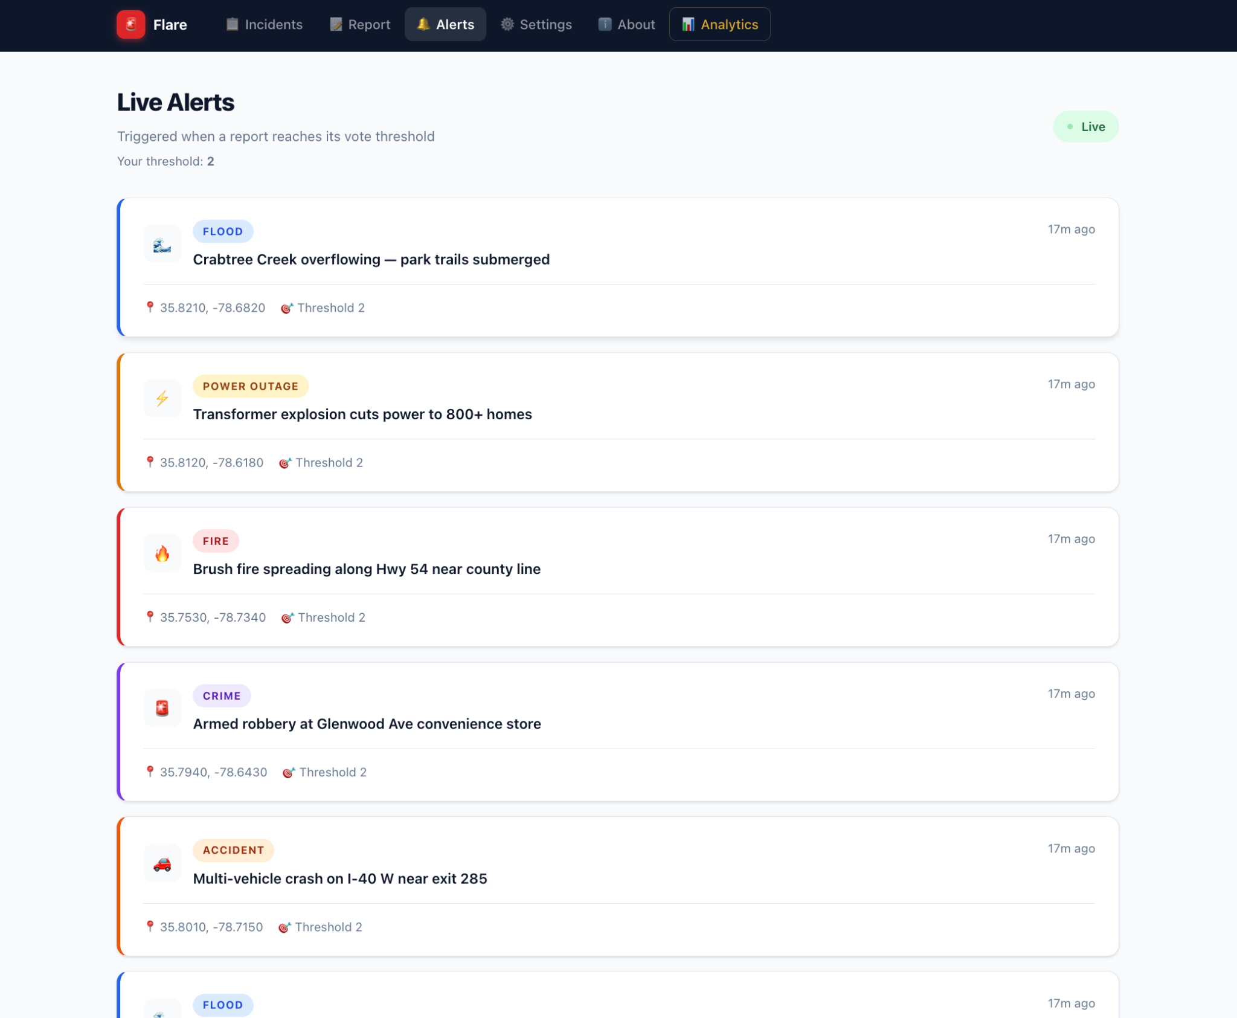
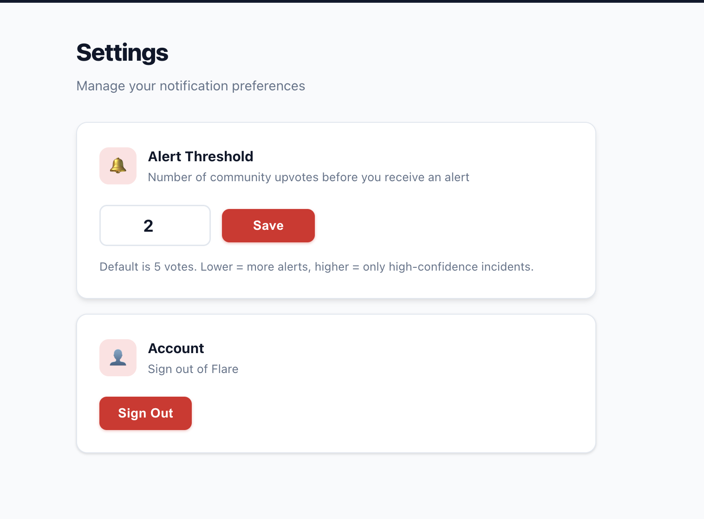
Alert Broadcast
Users will receive real-time notifications as verified incidents are verified by meeting the upvote threshold set by the user in settings. As new incidents meet the upvote threshold, they are added to the live alerts listing page.
Flare
Pearl Hacks
2026

Slide 7
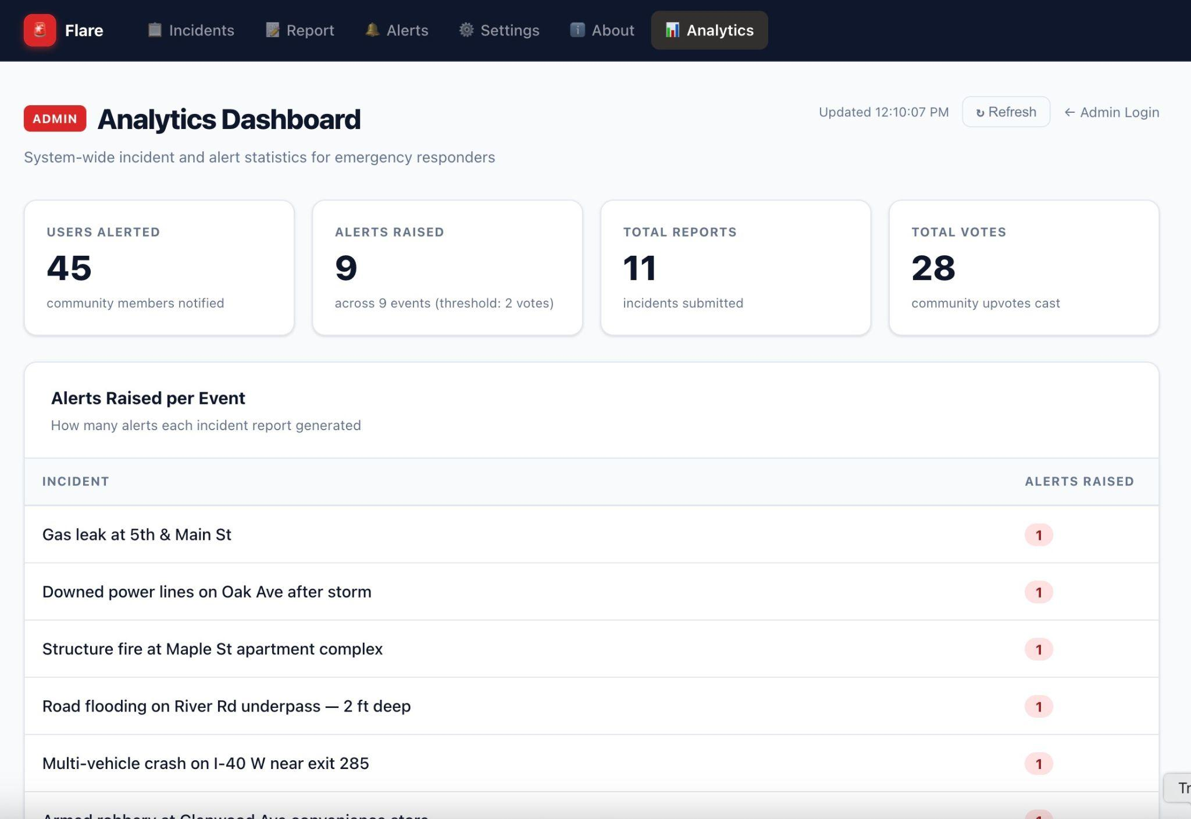
Admin Analytics Dashboard
Scope-
# of users alerted
# of alerts raised
Total reports
Total votes
Alerts raised per event
Users alerted per event
Flare
Pearl Hacks
2026

Slide 8
Tech Stack
Full-stack Architecture:
Next.js and React for a responsive frontend
FastAPI to handle our backend logic
Supabase for database management, with real-time features to push instant alerts to users

Slide 9
Live Demo!
Flare
Pearl Hacks
2026

Slide 10
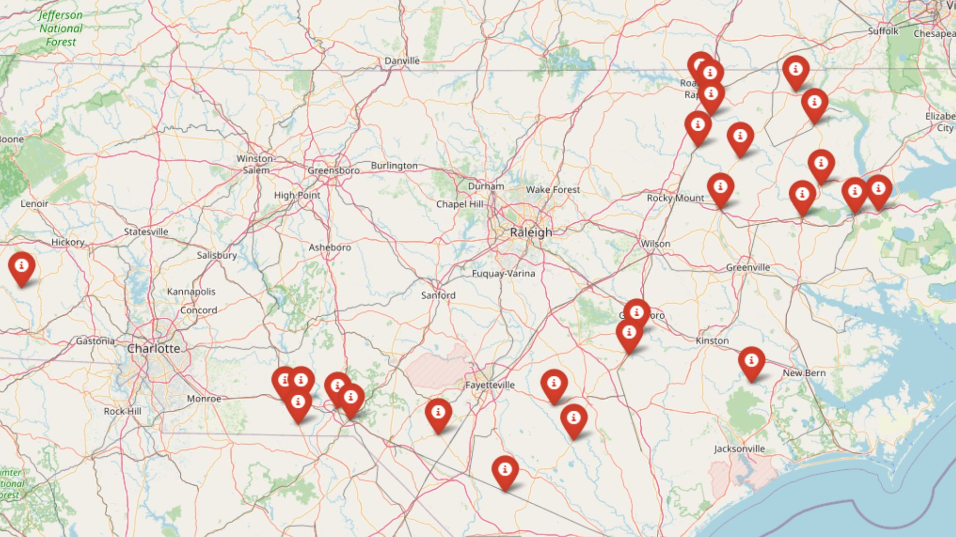
What’s Next for Flare
Next Steps:
Fine tuned model to find key word matches between two strings to group together the same instances of accidents
Implement a map to show different hazards according to the type of hazard given a user's location.
Allow users to join groups for certain communities

Slide 11
Questions?
Pearl Hacks
2026

Slide 12
Thank You!
Pearl Hacks
2026

Slide 13
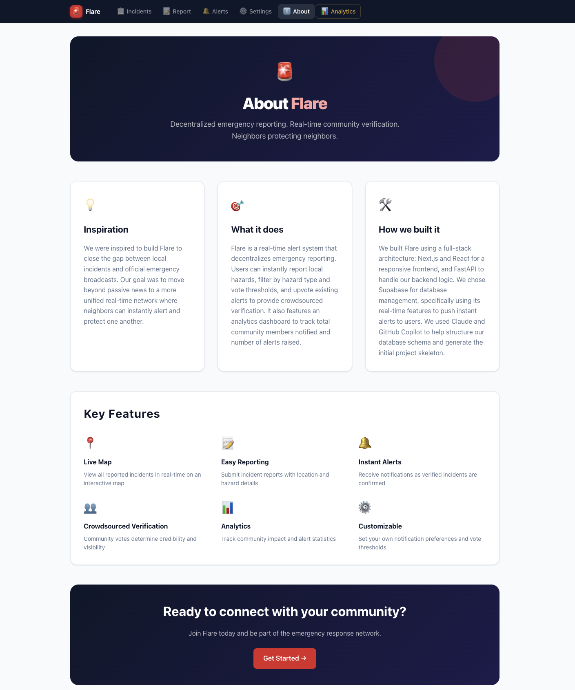
About
Our mission
Company Name
Quarter Month
Year

Slide 14
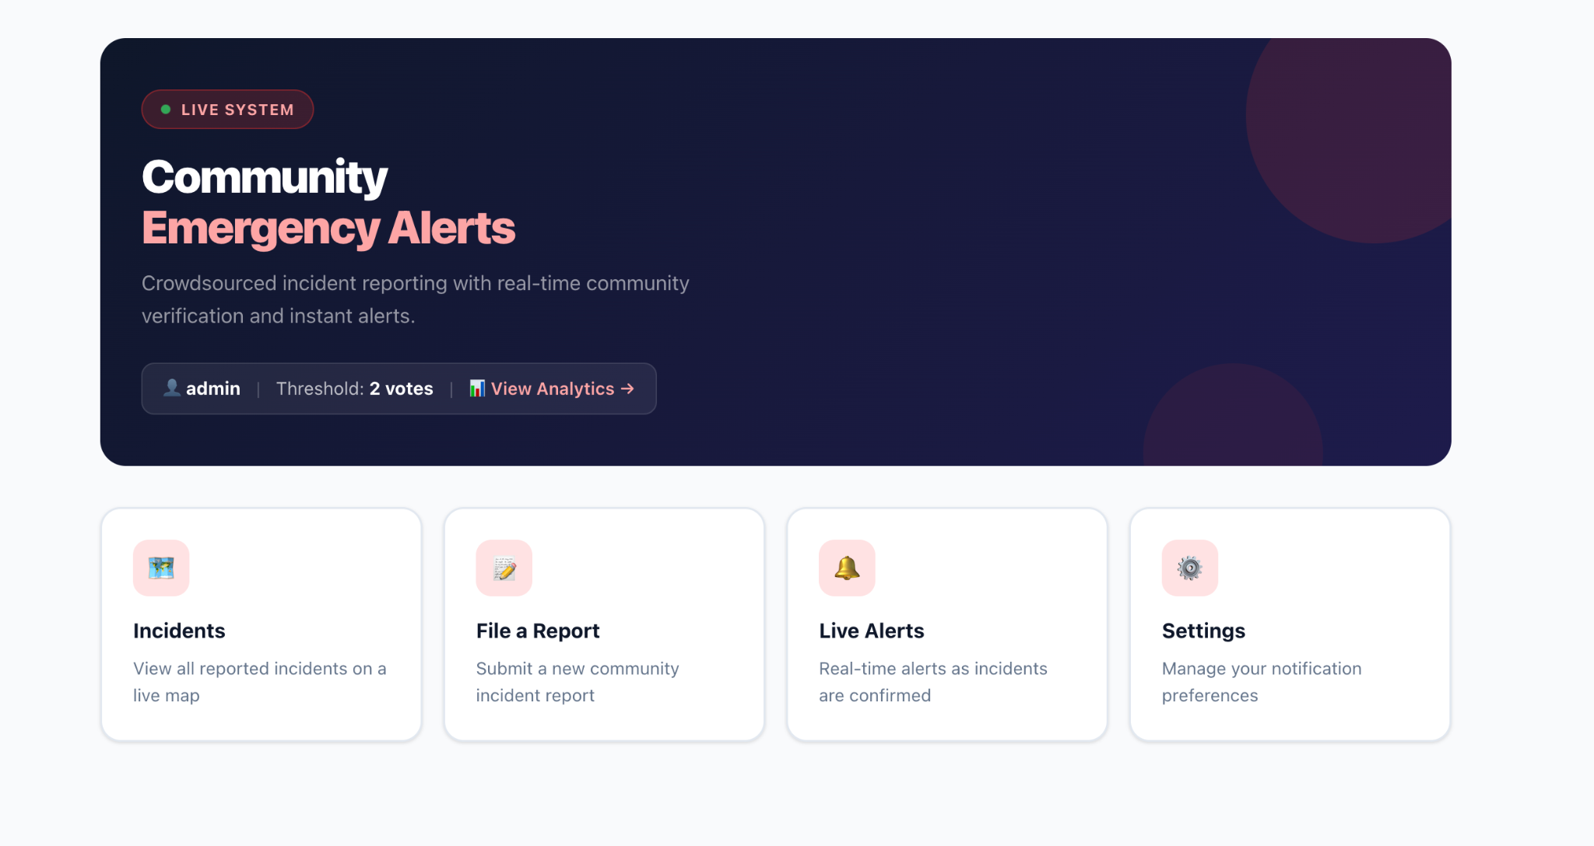
What we built
Our mission
Flare
Quarter Month
Year
Notes:
sanjana

Slide 15
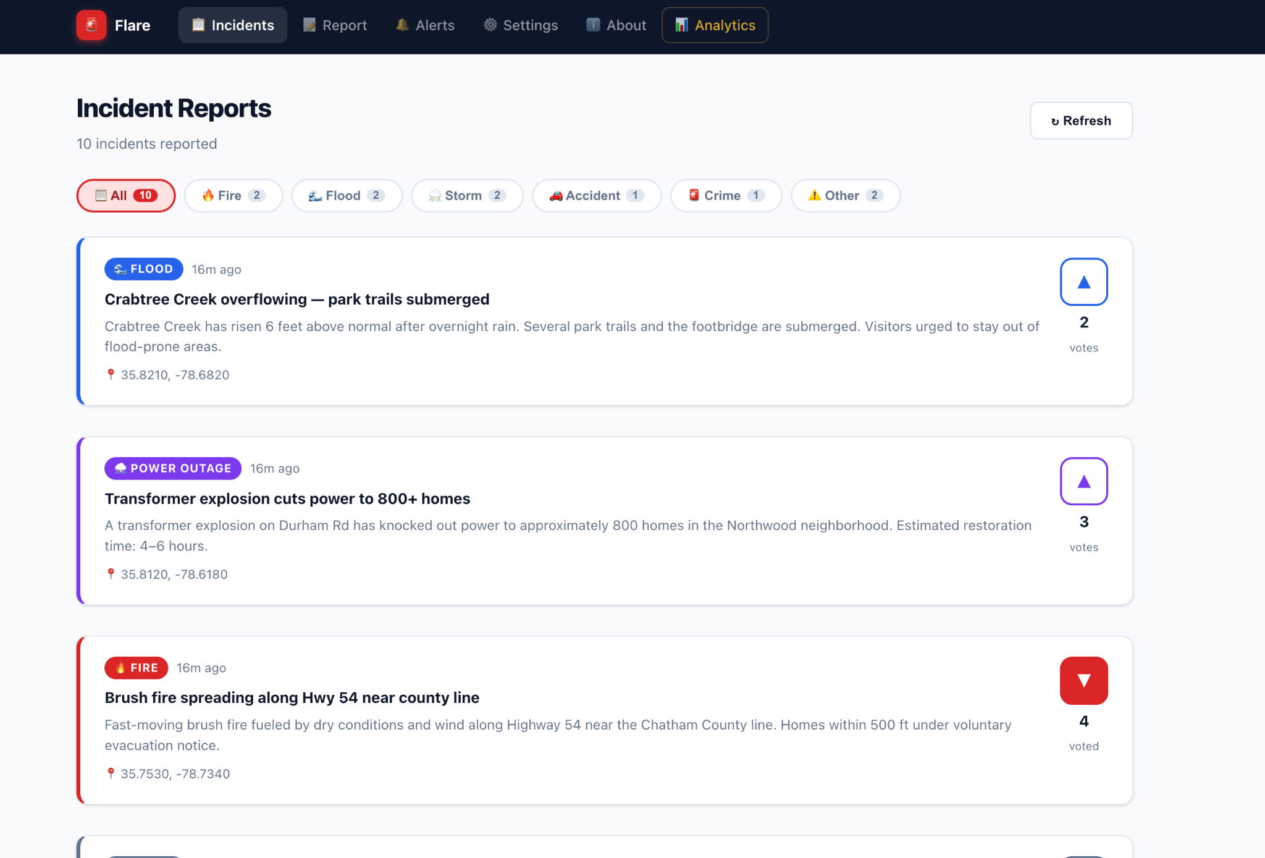
Incidents
Our mission
Company Name
Quarter Month
Year
Notes:
sophia

Slide 16
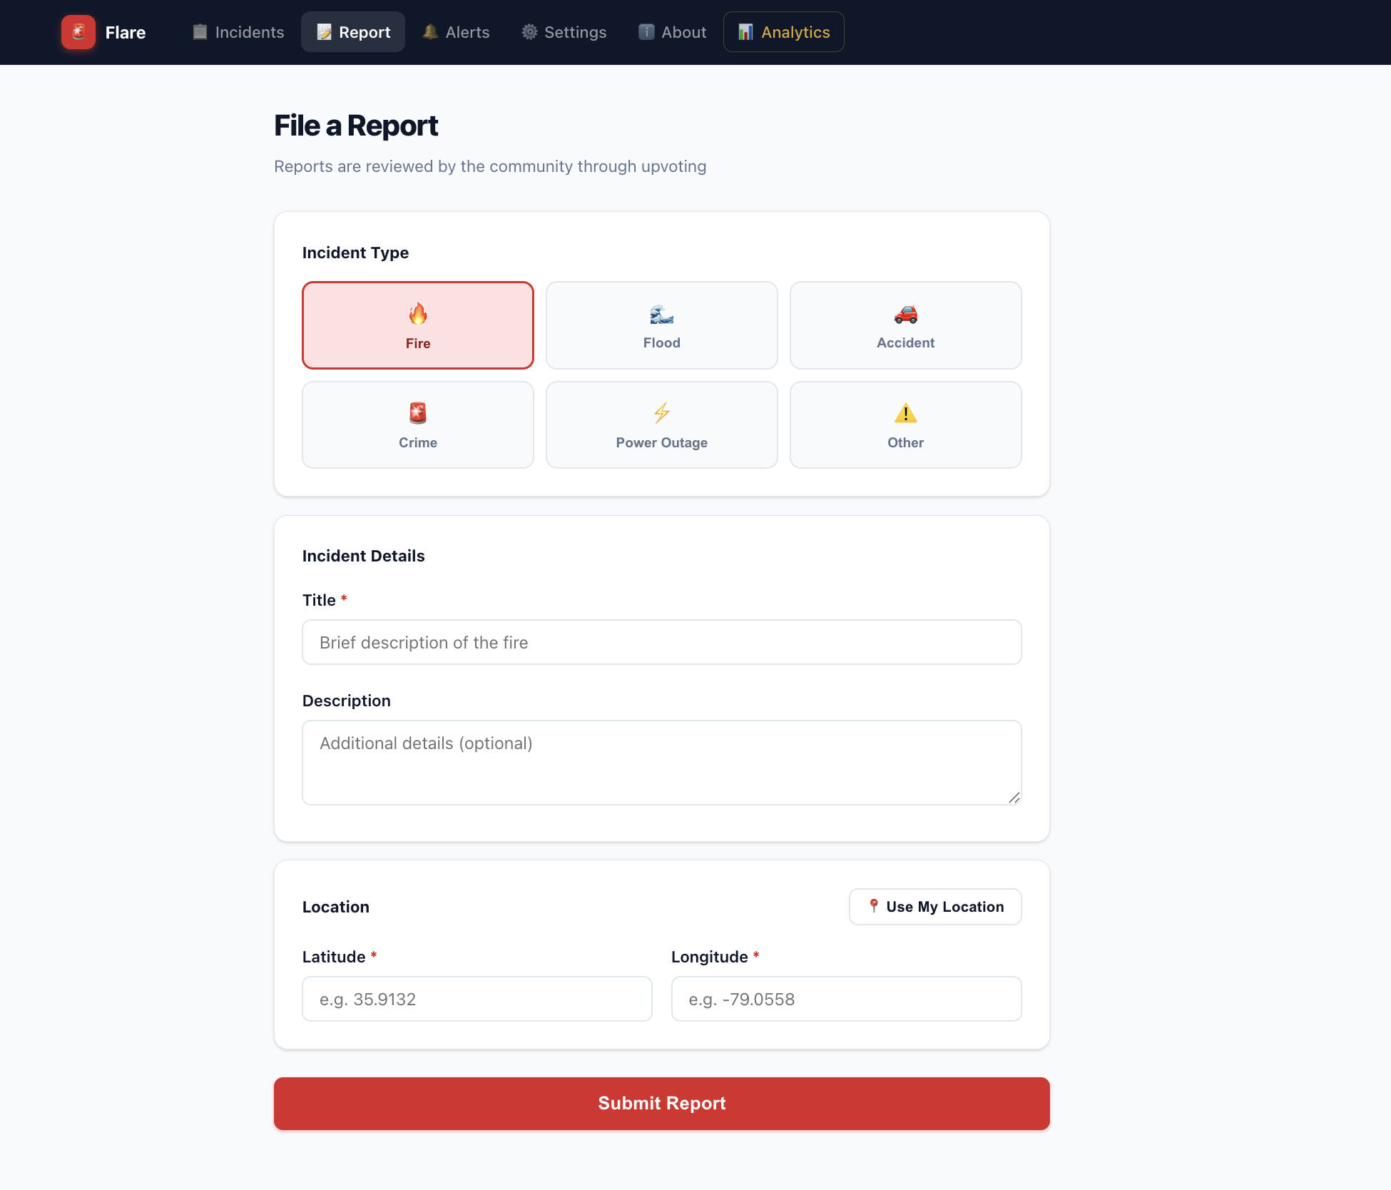
File a Report
Our mission
Company Name
Quarter Month
Year
Notes:
sophia

Slide 17
Live Alerts
Our mission
Company Name
Quarter Month
Year
Notes:
medha

Slide 18
Settings
Our mission
Company Name
Quarter Month
Year

